Slide 1
Enterprise Wikis and Social Networking
Notes:
In this module we will examine and see how to leverage the social networking features built into SharePoint 2010.

Slide 2
Agenda
Using My Sites in SharePoint
Term Store Management and Tagging
The User Profile Store
Create Enterprise Wikis

Slide 3

Information Worker Needs
Find knowledge
Use
content
Build a network
Share ideas
Work in teams
Manage projects
Feel valued
Notes:
Information workers are usually overloaded with information, but still they suffer from a shortage of true ‘knowledge’. Where do you go to get information you can trust… subject matter experts!
Social Computing networks out in market today: Facebook, LinkedIn, Blogs, Twitter all provide a lot of information, but there is a lot of noise out there as well. However, companies are definitely realizing that having knowledge is about having the right People and not just the documents and products.

Slide 4









Four Core Experiences
Social Networking
Social Content
widgets
Teamwork
Groups
Notes:
Working with SharePoint, an information worker needs to work together in teams, but also acts individually to create content and her own networks. The different facets of the SharePoint portal allows this type of flexibility.

Slide 5


















SharePoint Communities
Blogs, Wikis, Podcasts
Productivity tools
Tags and Feedback
Customization
Social Networking
Workspaces
Activity Feeds
Knowledge
People Search
PC
Browser
Phone

Slide 6

SharePoint’s Social Journey
My Sites
(2003)
Blogs & Wikis
(2007)
Kits
(2008+)
Notes:
SharePoint has dabbled in social computing since SharePoint 2003 when My Sites first came out. My Sites provided a great way for people to start hosting their documents, links and other personal information directly in their private site and have portions of it visible to users.
In 2007, SharePoint came out with Blogs and Wikis as well to further push into the web 2.0 features that have been accepted out in the market. Then in 2008, the podcasting kit and others like it made a splash. The kits are like accelerators pushing the limits of SharePoint to provide an easy mechanism for end users to share content.
SharePoint 2010 is Microsoft’s latest foray into social computing. The ‘Facebook like’ features of SharePoint 2010 will make it easier than ever for people to collaborate with their peers within the corporate environment.

Slide 7
My Site Components
My Network
My Profile
My Content
My <foo>
Pages
My Site
MySite Host
My Site
My Site
Site
Collections
My Web application
Web App
Managed Metadata
User Profiles
Search
Service
Application
Proxies
Notes:
My Sites are individualized sites created for each user profile that contain personal information about the user as well as personal and public views of information, documents, and other content. My Sites allow individuals to add colleagues and organize them into logical groupings. By using My Sites, users can keep track of their own activities as well as their colleagues.

Slide 8
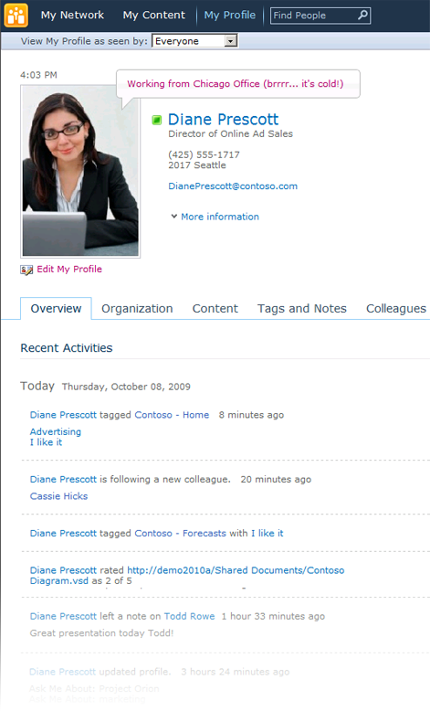
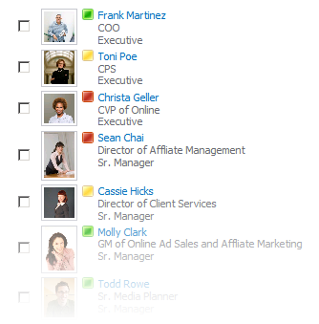
My Site
My Site personal portal
Social Feedback
People and Expertise Search
Notes:
My Sites also have a Note Board feature which works very much like theFacebook Wall where any one of your colleagues can write a message for you.
The My Network page in a My Site is a built in newsfeed. A running newsfeed of your colleagues’ activities (birthday, someone added a Tag, uploaded a document etc).
The My Profile page of the My Site also provides the user a microblogging platform sort of like Twitter.

Slide 9












My Profile
Friends
And
Colleagues
Job
History
Blogs,
News,
Interests,
Things to Watch
Family
Photos
Communities
Notes:
In My Profile page, a user can choose to provide as much or as little information they wish to. They can also change the view-ability of each item on the page to scope to a certain audience. For example, show my home phone number only to my manager while show my interests and skills only to my colleagues and manager, but not anyone else.
When another person visits your My Profile page, they are only able to see the information that they have privileges to see.

Slide 10
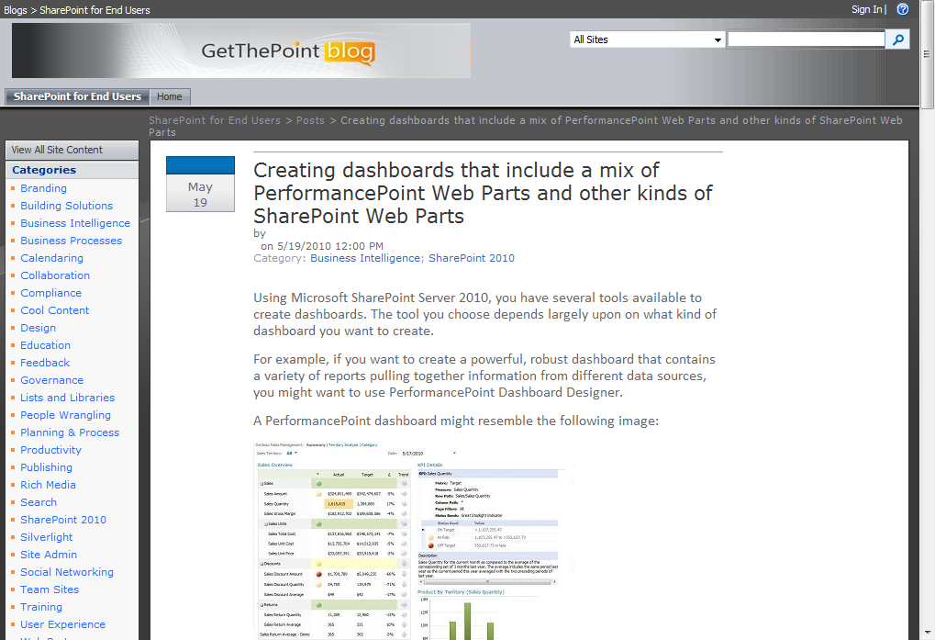
Blog
Individuals can create their Blogs directly under their My Site
Notes:
Blogs are a real efficient way to communicate information or share thoughts and experiences informally to a group of people. Individuals and teams both can have blogs internal to the company or out on the internet.
The Blog site template come out-of-the-box so a blog site can be created at any level within the portal. For an individual wanting to host a blog, it is recommended to host the blog under their My Site. It’s a one click process to create the blog site. Either the browser (which provides WYSIWIG editing) or Microsoft Word can be used to post entries to the blog.

Slide 11
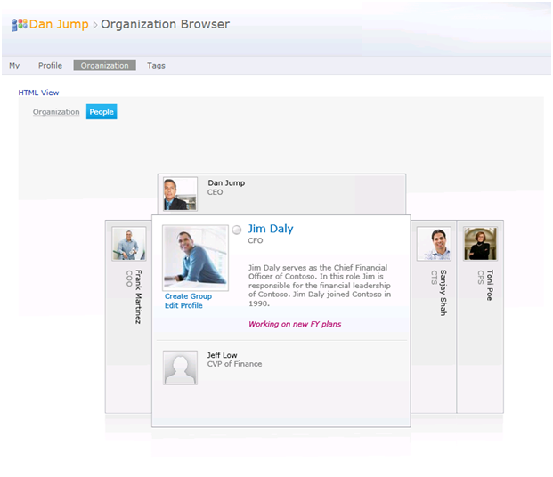
Organization Browser
Available in Silverlight and HTML versions
Dynamic view of Organization’s employees and the company hierarchy
Notes:
Organization Browser - Silverlight or HTML version.
This is an Overlay directory to find people and their relationship to each other and to you. Who does a person work for? More info about them etc. See a digest from their presence. Their status message. Drill down to their direct reports. Import this from LOB system. Control delegation of it: ex - managers can control their subordinates etc.

Slide 12
DEMO
Tour of My Sites

Slide 13
Agenda
Using My Sites in SharePoint
Term Store Management and Tagging
The User Profile Store
Create Enterprise Wikis

Slide 14

Term Store
Managed Metadata Service Application
Content Type Hub
Term Store
One term store per shared service application
Content Types
Group(s)
Many groups per term store. Used as security boundary
Term Set(s)
Many term sets per group
(max 1000 total per term store)
Term(s)
30K terms per term set
(max. 1m total)
Synonyms
Description
Translations
Custom properties
Notes:
Term Store - DB that contains one or more taxonomies available as a Service Application.
Term - Node in the taxonomy with a unique ID and many text labels.

Slide 15
Term Store Management Tool
Home →Site Setting → Site Administration →Term Store Management
Service Management
1
Access all available term stores from one location
Security Groups
2
Control how you can edit/delete/create using SharePoint groups and users
Term Sets
3
Create and manage different hierarchies that share terms
Same term can have different parents in different term sets
Each term set can have unique sort order
Allow/disallow end user updates
Notes:
From within a site, navigate to Site Settings and then click on Term Store Management to see all available term stores from a single location.

Slide 16
Term Store Management Tool
Home →Site Setting → Site Administration →Term Store Management
Term Management
4
Copy
Reuse
Description
Merge
Import
Deprecate
Delete
Not available
Full multi lingual
Extensible custom properties

Slide 17
Applying Metadata: ‟Tagging”
Web Browser
1
List items can be tagged by using the ‟Edit Properties” UI
By a business process
By virtue of the location in which we choose to store the item (location based metadata)
Values from the parent Doc Set
Office Clients
2
Document Information Panel allows for tagging in the authoring surface of the Office client
Backstage in the Office clients will allow full fidelity of the managed metadata controls
InfoPath forms
Custom Apps
3
3rd party or custom applications using SharePoint Metadata OM
Notes:
Tagging is available all throughout the publishing pages. Any of the terms can be used to ‘Tag’ an artifact.
Tagging an item is available through the browser, office applications and also custom applications.

Slide 18
Metadata Field & Features
Managed Keywords Column & Social Tagging Control
Closed Term Set
Open Term Set
Keywords Set
Type-ahead
Disambiguation
MUI support
Description
Synonyms
Tree Picker
Add new Term
Validates all terms
Upload
Controlled & managed
Flexible & open

Slide 19
Managed Metadata Field Type
Managed Metadata
1
Single or multi-value field
Binds to a term set of any term store (Service Application)
Many managed metadata column on a list, library, or content type
‟Like a super choice field”
Inclusive/exclusive filtering
MUI enabled
Most recently used
Managed Keywords
2
Now part of the base doc content type
One per content type
Validates against all terms in all term sets
Always for ‟folksonomies”
‟Like a super text field”
Auto-complete
Disambiguation
Preferred term
Tree picker control
Notes:
A new column type is available in Lists called Managed Metadata. This column type, when chosen, connects directly to the Term Store and will you pick the Term Set that has the information you would like to see in the column.

Slide 20
DEMO
Term Store Management and Tagging

Slide 21
Agenda
Using My Sites in SharePoint
Term Store Management and Tagging
The User Profile Store
Create Enterprise Wikis

Slide 22
Business System Centric Systems
User 1
User 6
User 2
Business System
User 5
User 3
User 4
Notes:
Usual business schemes are very much business system centric. All player work on the same system but from different perspectives.

Slide 23
User Profile Store: Person Centric
UX
My Site
Profile
Newsfeed
Web Service
Social Network
Jeff
Profile Store
Organizational
Role and Policies
Profile
Synchronization
Notes:
The user profile store is very person centric. The person is the entity that interacts with multiple systems and people in a variety of ways.

Slide 24
User Profile Store: Person Centric
UX
My Site
Profile
Newsfeed
UX
My Site
Profile
Newsfeed
Web Service
Social Network
Web Service
Social Network
Jeff
Tom
Profile Store
Organizational
Role and Policies
Profile Store
Organizational
Role and Policies
Profile
Synchronization
Profile
Synchronization
Social Network
UX
My Site
Profile
Newsfeed
UX
My Site
Profile
Newsfeed
Web Service
Social Network
Web Service
Social Network
Lauren
Mike
Profile Store
Organizational
Role and Policies
Profile Store
Organizational
Role and Policies
Profile
Synchronization
Profile
Synchronization
Notes:
A social network consists of multiple user profile systems.

Slide 25
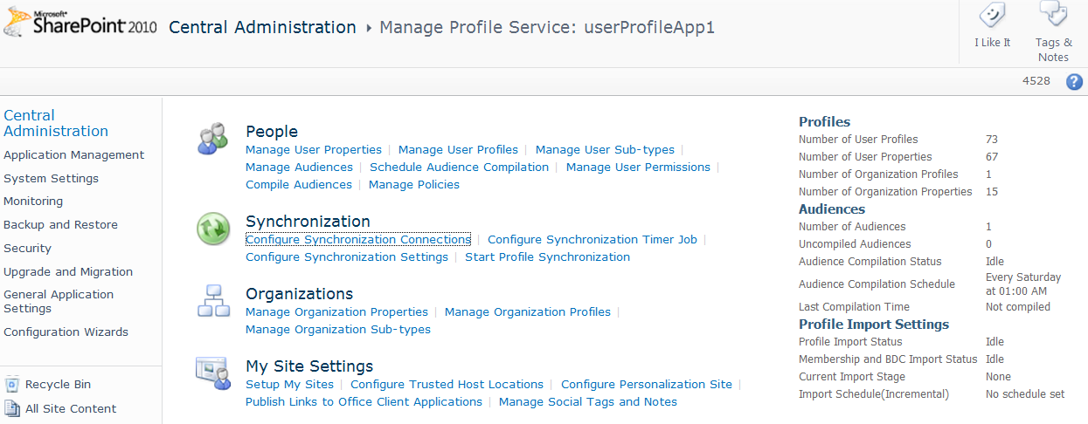
Key User Profile Service Considerations
Profile Customization
Profile Store architecture
Profile Synchronization
Scale
Performance
Federation and Replication

Slide 26
Profile Store Architecture
User Profile DB
Profile and Activity Feed
Social Data DB
Tags, Keywords, Comments, Bookmark, Ratings
Mainly stores GUID (to the taxonomy term) or the note or rating, URI, Profile ID, Timestamp, URI disambiguation info
Term values for use on the Newsfeed and Tags & Notes Page
Sync DB
Staging sync data for AD, LDAP, BCS

Slide 27
DEMO
Walkthrough of User Profile Store

Slide 28
Agenda
Using My Sites in SharePoint
Term Store Management and Tagging
The User Profile Store
Create Enterprise Wikis

Slide 29


Community Powered Wikis
Ribbon UI
SharePoint Workspace
SharePoint Mobile
Office Client and Office Web App Integration
Standards Support
Business Connectivity Services
InfoPath Form Services
External Lists
Workflow
SharePoint Designer
Visual Studio
API Enhancements
REST/ATOM/RSS
Tagging, Tag Cloud, Ratings
Social Bookmarking
Blogs and Wikis
My Sites
Activity Feeds
Profiles and Expertise
Org Browser
Sites
Composites
Communities
PerformancePoint Services
Excel Services
Chart Web Part
Visio Services
Web Analytics
SQL Server Integration
PowerPivot
Insights
Content
Enterprise Content Types
Metadata and Navigation
Document Sets
Multi-stage Disposition
Audio and Video Content Types
Remote Blob Storage
List Enhancements
Search
Social Relevance
Phonetic Search
Navigation
FAST Integration
Enhanced Pipeline
Notes:
Wikis are a way to manage content. They are integrated with the communities workload within the SharePoint space. Wikis empower communities to create content. The content is served to people based on their interests, tags, colleagues etc.
The Communities workload consists of the following components:
Enterprise Wikis
Team Sites
Tagging, Rating, Bookmarking
User Profiles
My Sites
Newsfeeds
Knowledge Mining
Blogs

Slide 30
Enterprise Wikis
SharePoint Server: Enterprise Wiki Site Template – built on SharePoint Publishing infrastructure
SharePoint Foundation: Team Sites with Web Edit
Page Templates
(Content Types & Page Layouts)
Categories
(Managed Metadata)
Easy page editing
Ratings
(Web Analytics)
Social Tags & Notes
(Social Store)
Wiki-linking with auto-complete
Customizable
(Master Pages & CSS)
Scalable
(Output Caching)
Cross-browser Rich Text Editor
Notes:
SharePoint Foundation provides the Web page editing experience that’s easy and intuitive for the end user. Adding content directly to a page, inserting pictures and linking one page organically to another is all done very easily. The end user can use their choice of the Web browser for editing pages. Firefox, Safari as well as Internet Explorer are all supported browsers.
This same easy editing experience is leveraged in the Enterprise wiki site template which can be used when creating a new site collection. Enterprise wiki is built on SharePoint publishing infrastructure and enjoys all of its benefits. You can create content types and then page layouts from these content types to define the type of content that can be created by the end users. All pages are enabled with categories, ratings and tags to let you define your content appropriately. Also, the wiki site is fully customizable using master pages and style sheets. Publishing capability like output caching is used to scale the site.

Slide 31
Wikis Powered by SharePoint Platform
Integration
- Line of business (LOB) data
- Managed metadata
- My Sites, Tags, Notes, Feeds…
Content Management
- Workflow
- Approval
Compliance
- Policy
- Auditing
- e-Discovery
Notes:
Since Enterprise wiki is powered by the SharePoint platform,the benefits of integration include the built in functionality of SharePoint Foundation. All functionality that’s available in SharePoint is available in wikis – external lists, managed metadata, my sites, tags, RSS feeds etc.
Just like other sites, you can turn on information management policy and auditing settings to keep the site in compliance.
The Wiki functionality empowers users to create content and is inherently ‘loose’ in nature. However, you can lock down things and ‘dial up’ the functionality to make this a full publishing site with workflows and approval for pages.

Slide 32
Enterprise Wiki Architecture
Enterprise Wiki is a Publishing Site
Branded using familiar Master pages and CSS
Extended using content types and page layouts
Scalable via publishing feature cache scheme
Enterprise Wiki using Managed Metadata
Site provisioning causes group creation
Metadata column automatically added

Slide 33
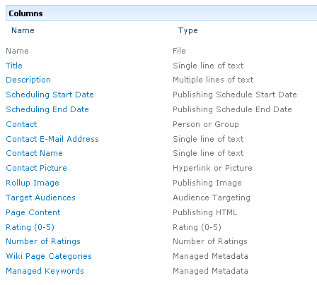
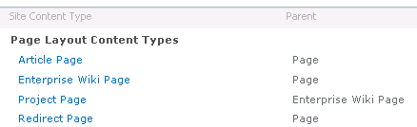
Content Types
Enterprise Wiki Page Content Type
Adds columns for ratings
Adds columns for tracking metadata
Notes:
The Enterprise Wiki Page content type consists of the site columns needed for providing the ratings, categories and keywords functionality within Wiki pages.

Slide 34
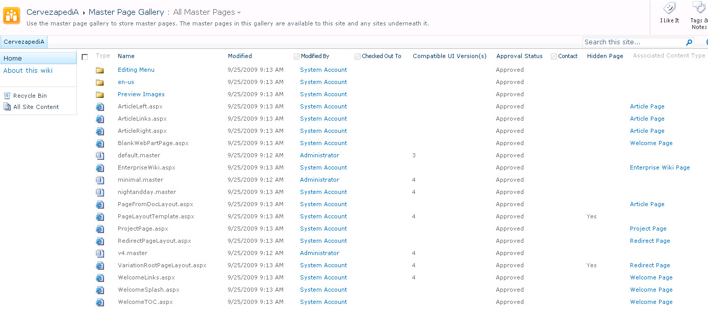
Page Layouts
Enterprise Wiki Page Layout
Notes:
The Enterprise Wiki content type was used to create the EnterprieseWiki.aspx page layout (comes out of the box). This can readily be used to start creating wiki pages in the site.

Slide 35
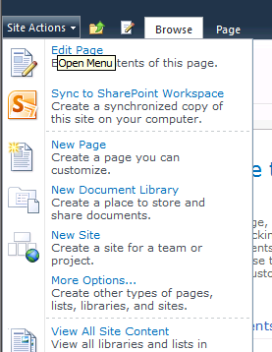
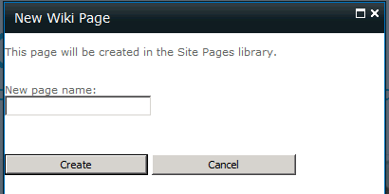
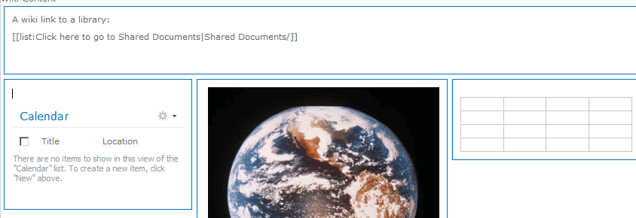
Pages Everywhere
Every team site has a pages library
Create a new page with a single click
[[Wiki Linking]]
Pages
Lists
Items
Documents
Notes:
The Enterprise Wiki site has a Wiki Pages library that stores page content. Wikis have a rich interaction model and allow a site to be easily stitched together using groups of pages and Wiki linking. It is very easy to add new Wiki pages to a site. The New Page button is one of the primary buttons in the Site Actions menu. The dialog only asks the absolute minimum of information it needs to create a page, and then the editing experience kicks in.

Slide 36
DEMO
Enterprise Wikis

Slide 37
Summary
Using My Sites in SharePoint
Term Store Management and Tagging
The User Profile Store
Create Enterprise Wikis

